Slide 1

Unused Medicine Donation
Sandip Nepali,191724
Apsara B.k.,191704
Rudra.N.Pandey,191720

Slide 2




Table of contents
1
2
3
ABOUT MEDICINE DONATION
Why online
Donation system?
How it Works?

Slide 3

ABOUT
MEDICINE DONATION

Slide 4

Medicine Donation System?
Unused Medicine Donation System To prepare a portal for the collection of unused medicines that can be further utilized by people.

Slide 5
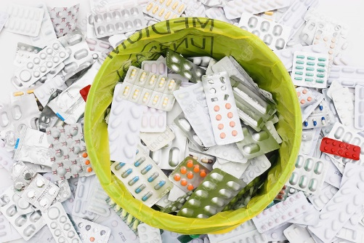
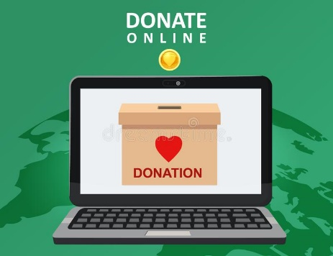

Unused medicine
Donate online
Reuse of medicine

Slide 6

PROBLEM OF STATEMENTS
Poor people can’t afford medicine that increases the death rate. The Medicine Donation system proposed here aims at providing an online platform for donating medicines or unused medicines to needy people.
Unexpired medicines that can be reused are wasted due to less awareness
among people about online medicine donation
Users can register themselves on this system by submitting their necessary details. Once registered the users can donate the medicines by providing accurate medicine details to Social organization

Slide 7

Why Online Medicine Donation System?

Slide 8
Objectives
I. To develop and development of website , which will be very effective and will bear great contribution to get the health services for these needy people and poor people,
II. Wastage of medicine gets reduce,
III. Besides this , with the help of web-based tools , social organizations can be directly connected to the outer sources

Slide 9
Medicine help for poor people
Social service

Slide 10
Wastage of medicine gets reduced
FROM WASTE TO LIFE

Slide 11
This system will contribute to reduce the cost for national health services by making the proper use of unused medicines donation system.

Slide 12

Online giving makes it much easier for donors to make regular donations.
This system can be used by multiple people at a time. People can donate at any time.
.
Online donation builds automation into the process to save you time & No more manual entry into spreadsheets

Slide 13
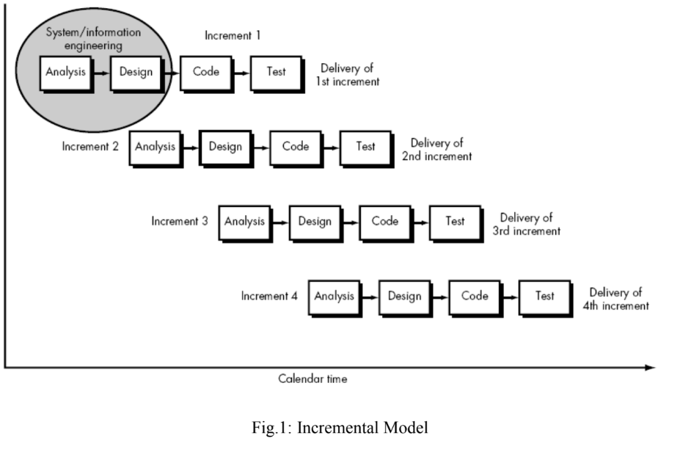
METHODOLOGY

Slide 14

3

Slide 15

There must be a log in for the User, Social Organization, admin.
Users can register themselves on this system by submitting their necessary details.
Once registered the users can donate the medicines by providing accurate medicine details to Social organizations
User can visit site and can request medicine also can donate medicine with detail information

Slide 16
Manages the System
ADMIN
Delivers to the needy people
NGOS
Requests medicines
Needy people
Donates medicine
DONAR

Slide 17
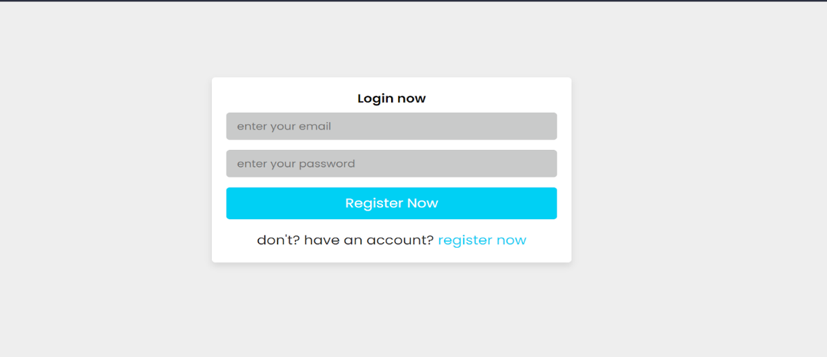
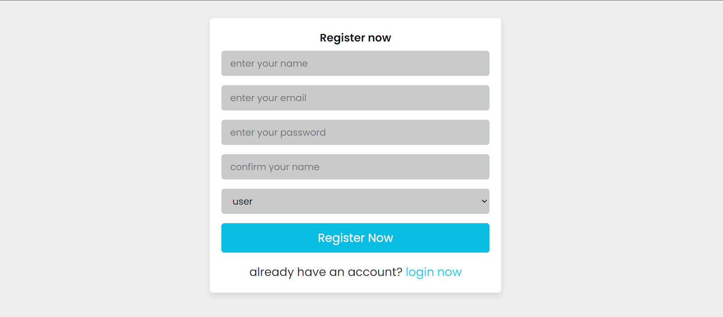
DOANTE
REQUEST

Slide 18
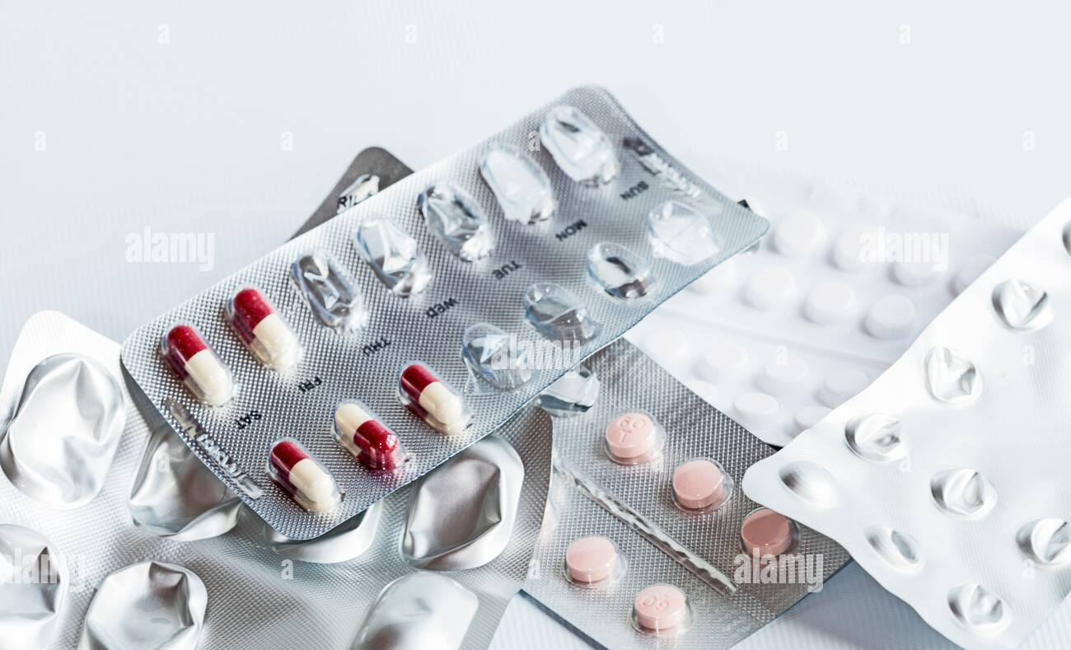

APPROVAL OF ONLY UNEXPIRED MEDICINES

Slide 19
WHAT NEXT ?
ONLINE BLOOD BANK
ONLINE DOCTOR APPOINTMENT
ONLINE ORGAN DONATION MANAGEMENT

Slide 20
WORK DISTRIBUTION
SANDIP NEPALI | BACKEND/DESIGN(FIGMA)
RUDRA R.PANDEY | FONTEND
APSARA BK | DOCUMENTATION

Slide 21
THANK YOU!

